Slide 1

Customer Segmation
13-May-2023

Slide 2
Team Details
Group Name: Go Bear!
Name: Xiaoke Song
Email: xiaokesong57@gmail.com
Country: US
College: UC Berkeley
Specialization: Data Science

Slide 3
Agenda
Problem Statement
2. EDA
3. Final Recommendation

Slide 4
Problem Statement
Customer Segmation:
“XYZ bank wants to roll out Christmas offers to their customers. But Bank does not want to roll out same offer to all customers instead they want to roll out personalized offer to particular set of customers. If they manually start understanding the category of customer then this will be not eﬀicient and also they will not be able to uncover the hidden pattern in the data ( pattern which group certain kind of customer in one category). Bank approached ABC analytics company to solve their problem. Bank also shared information with ABC analytics that they don’t want more than 5 group as this will be ineﬀicient for their campaign.”

Slide 5
EDA
Age Distribution

Slide 6
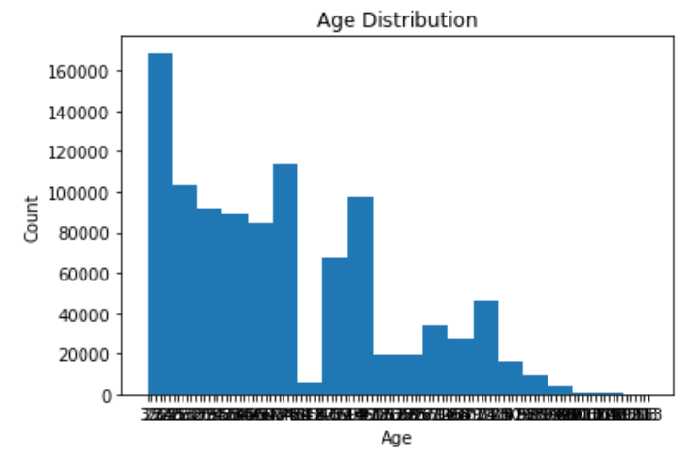
Most target customers are under 40 years old.

Slide 7
EDA
Correlation Matrix

Slide 8
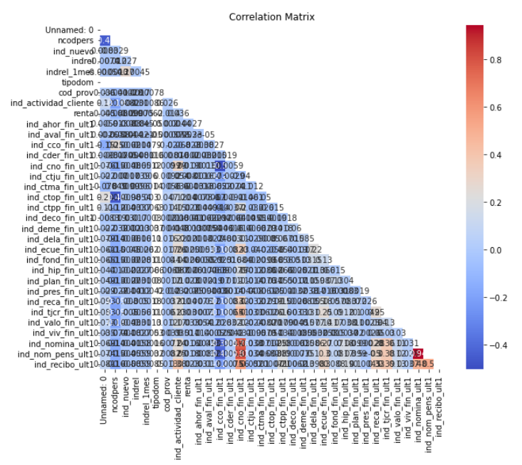
Most two variables in the dataset are not really correlated.

Slide 9
Final Recommendation
Based on the EDA performed, we can make the following recommendations for the company:
The dataset contains missing values, outliers and categorical variables that need to be preprocessed before analysis. The missing values can be filled with appropriate values such as mean, median or mode depending on the distribution of the data. Outliers can be removed or handled using appropriate techniques such as winsorization or transformations. Categorical variables can be encoded using one-hot encoding or label encoding techniques.
The distribution of the target variable (y) indicates that the dataset is imbalanced, with a higher proportion of negative outcomes than positive outcomes. This could potentially impact the model’s performance and should be considered during model training.
The correlation heatmap shows that some of the numerical variables are strongly correlated with each other, which may lead to multicollinearity issues during model training. Feature selection or dimensionality reduction techniques can be used to reduce the number of features and improve model performance.
The box plot of age distribution by gender shows that there are some outliers in the data. These outliers could potentially impact the model’s performance and should be handled accordingly.
The histogram of numerical variables shows that most of the variables have a skewed distribution. Transformations such as log, square root or box-cox transformations can be used to reduce the skewness and improve the model’s performance.
The scatter plot matrix shows that there is no strong correlation between the numerical variables and the target variable (y). This indicates that a simple linear regression model may not perform well on this dataset, and more complex models such as decision trees, random forests or neural networks may need to be explored.
Finally, it is recommended to use cross-validation techniques such as K-fold or stratified K-fold to evaluate the performance of the models on the imbalanced dataset. This will ensure that the model is able to generalize well on new unseen data.

Slide 10
Thank You

